Slide 1


VERSE: Versatile Graph Embeddings
from Similarity Measures
Anton Tsitsulin¹ Davide Mottin¹ Panagiotis Karras² Emmanuel Müller¹
¹
²
Notes:
;-)

Slide 2

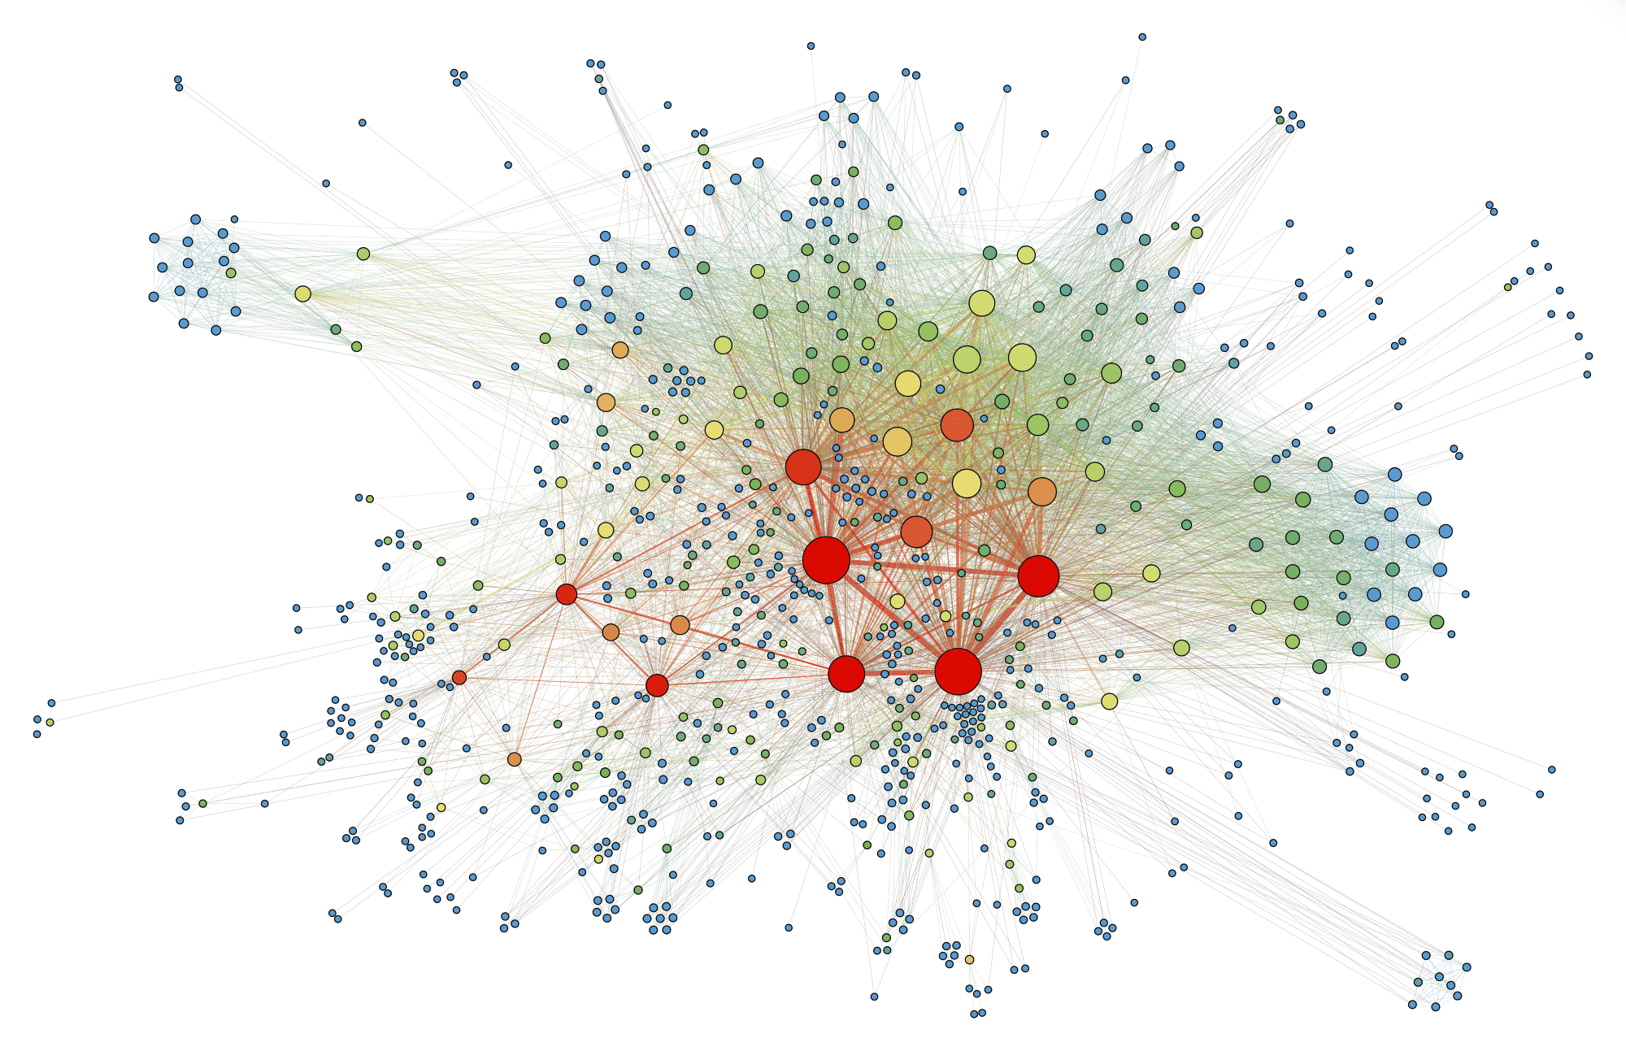



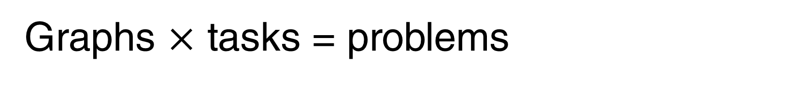
Graphs $×$ tasks = problems
Will Nathan like Camille?
Will Nathan vote for candidate T.?
Different domains:
  Social nets
  Biology
  WWW
Different tasks:
  Classification
  Clustering
  Link prediction

Slide 3

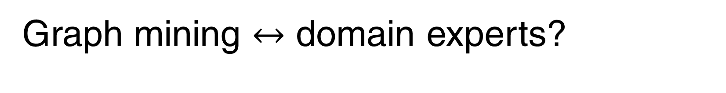
Graph mining $↔$ domain experts?
Will Nathan like Camille?
Will Nathan vote for candidate T.?
  Link prediction
  Classification
  Clustering
  …

Slide 4


Representations to the rescue
We have fast algorithms for mining vector data…
low-dimensional representation
k-means
Q: How to represent a graph's nodes as vectors?
Notes:
Man shall not live by bread alone

Slide 5
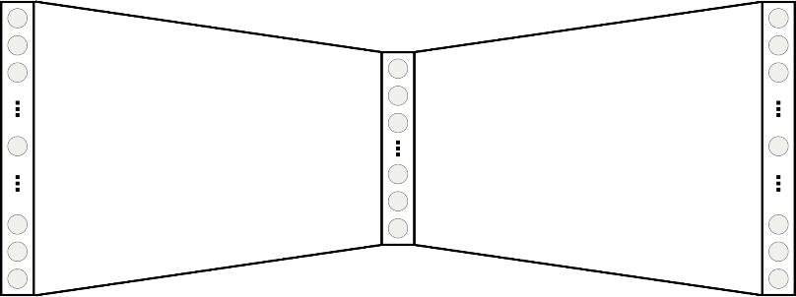


Neural node representations
Nodes in random walks $≈$ words in sentences $→$ word2vec
Random walks^{[2,3]}
Self-supervised neural network^{[1]}
$$W$$
$$W^{T}$$
representation
[1] Efficient Estimation of Word Representations in Vector Space, Mikolov et al., NIPS 2013
[2] DeepWalk: Online Learning of Social Representations, Perozzi et al., KDD 2014
[3] node2vec: Scalable Feature Learning for Networks, Grover & Leskovec, KDD 2016
Notes:
DeepWalk runs fixed-length walks from each node
Node2vec attempts to bias to tune for graph types, but has a worst-case cubic complexity, and average of m^2/n

Slide 6
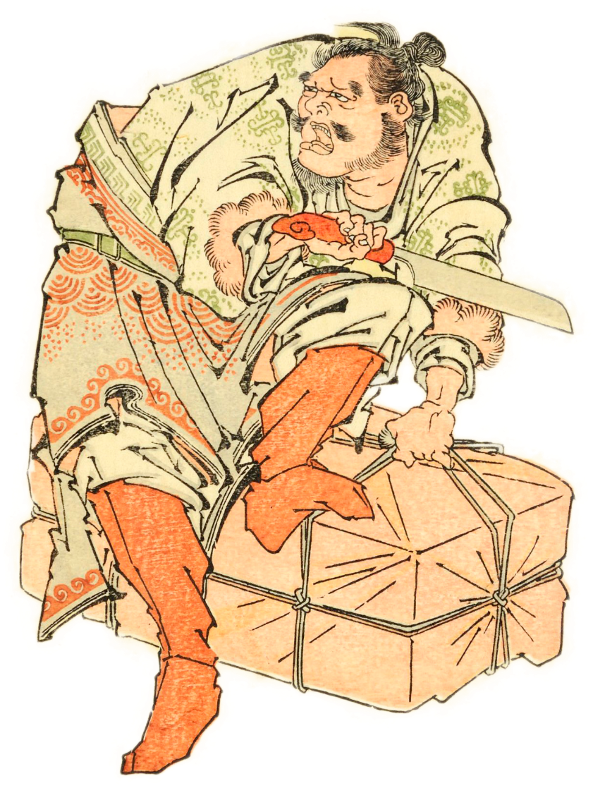
Wait, what?
Do we know what do these walks mean?
What do parameters change?
What does the model optimize?
word2vec can be understood as matrix factorization!
Yes, but the assumptions are too strict!
dimensionality = number of nodes
Notes:
For example, for node2vec there are 5 parameters
parameters are graph-dependent!
MF models are slow, HOPE worst-case quadratic

Slide 7
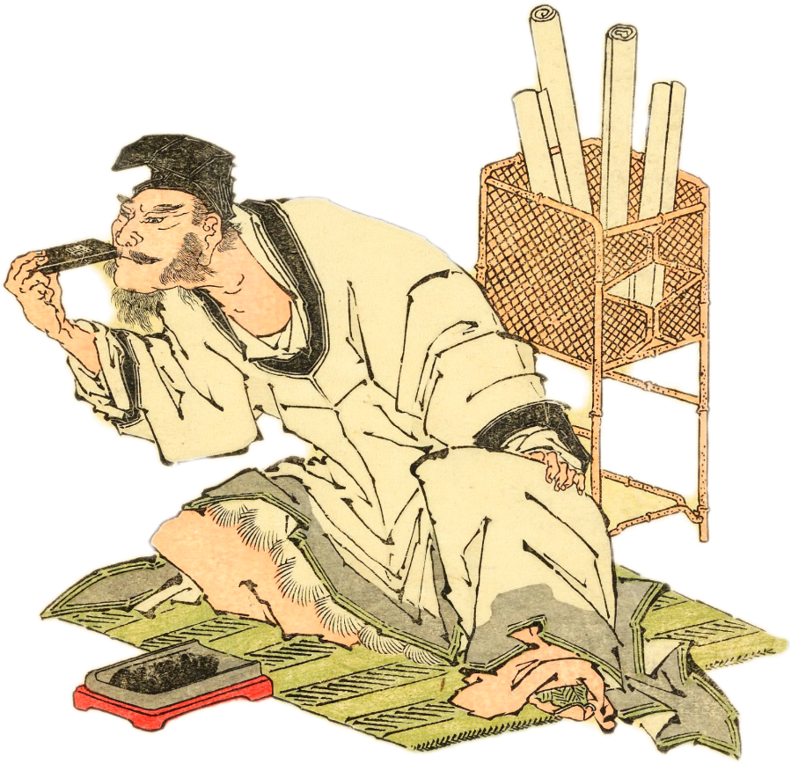
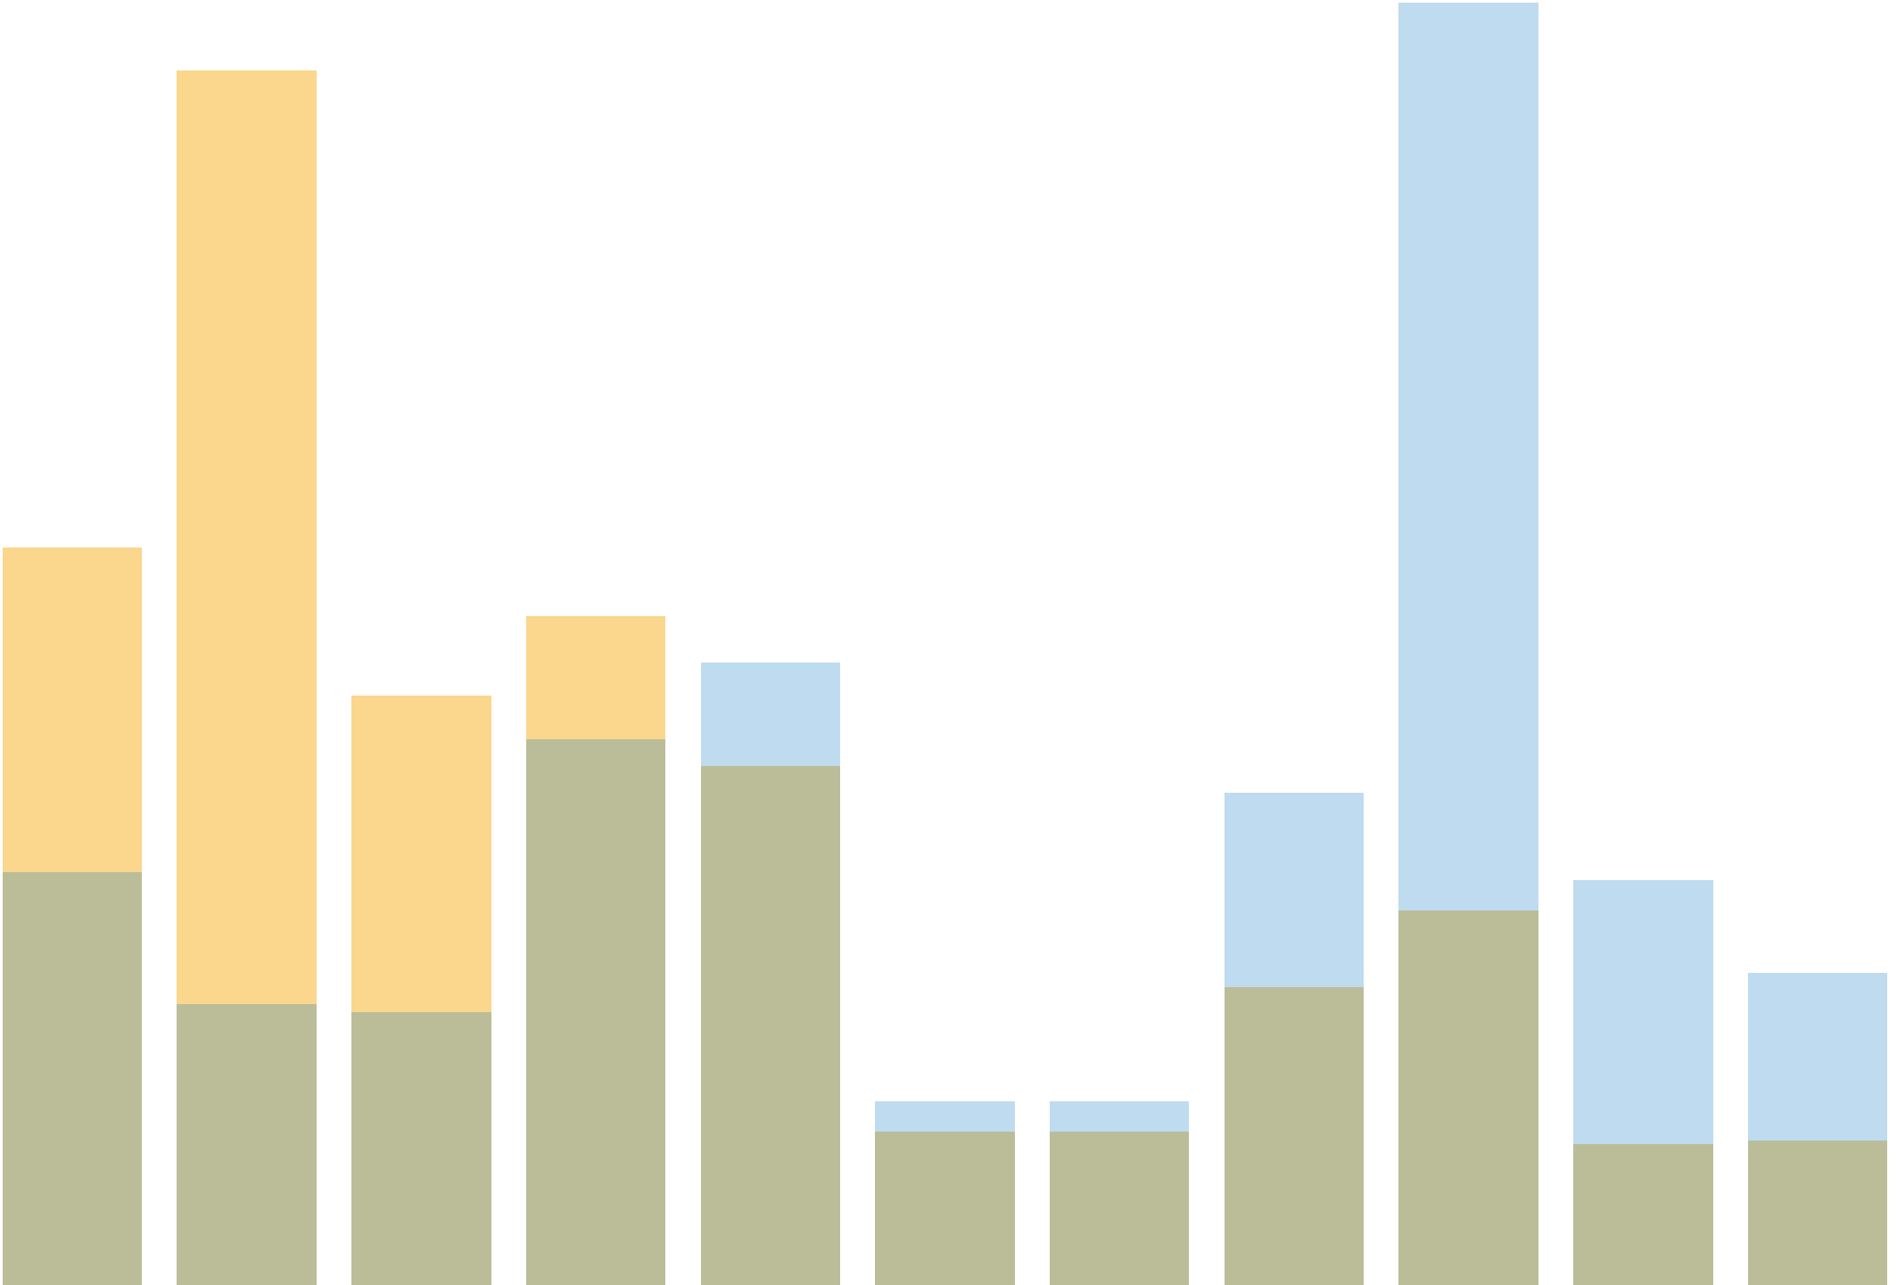






Key observation
Random walks define node similarity distributions!
Random walks converge to Personalized PageRank
$sim(u,⋅)$
$sim(v,⋅)$
$$u$$
$$v$$
$$u$$
$$v$$
Q: Can we inject similarities fully into the model?
Notes:
Man shall not live by bread alone

Slide 8
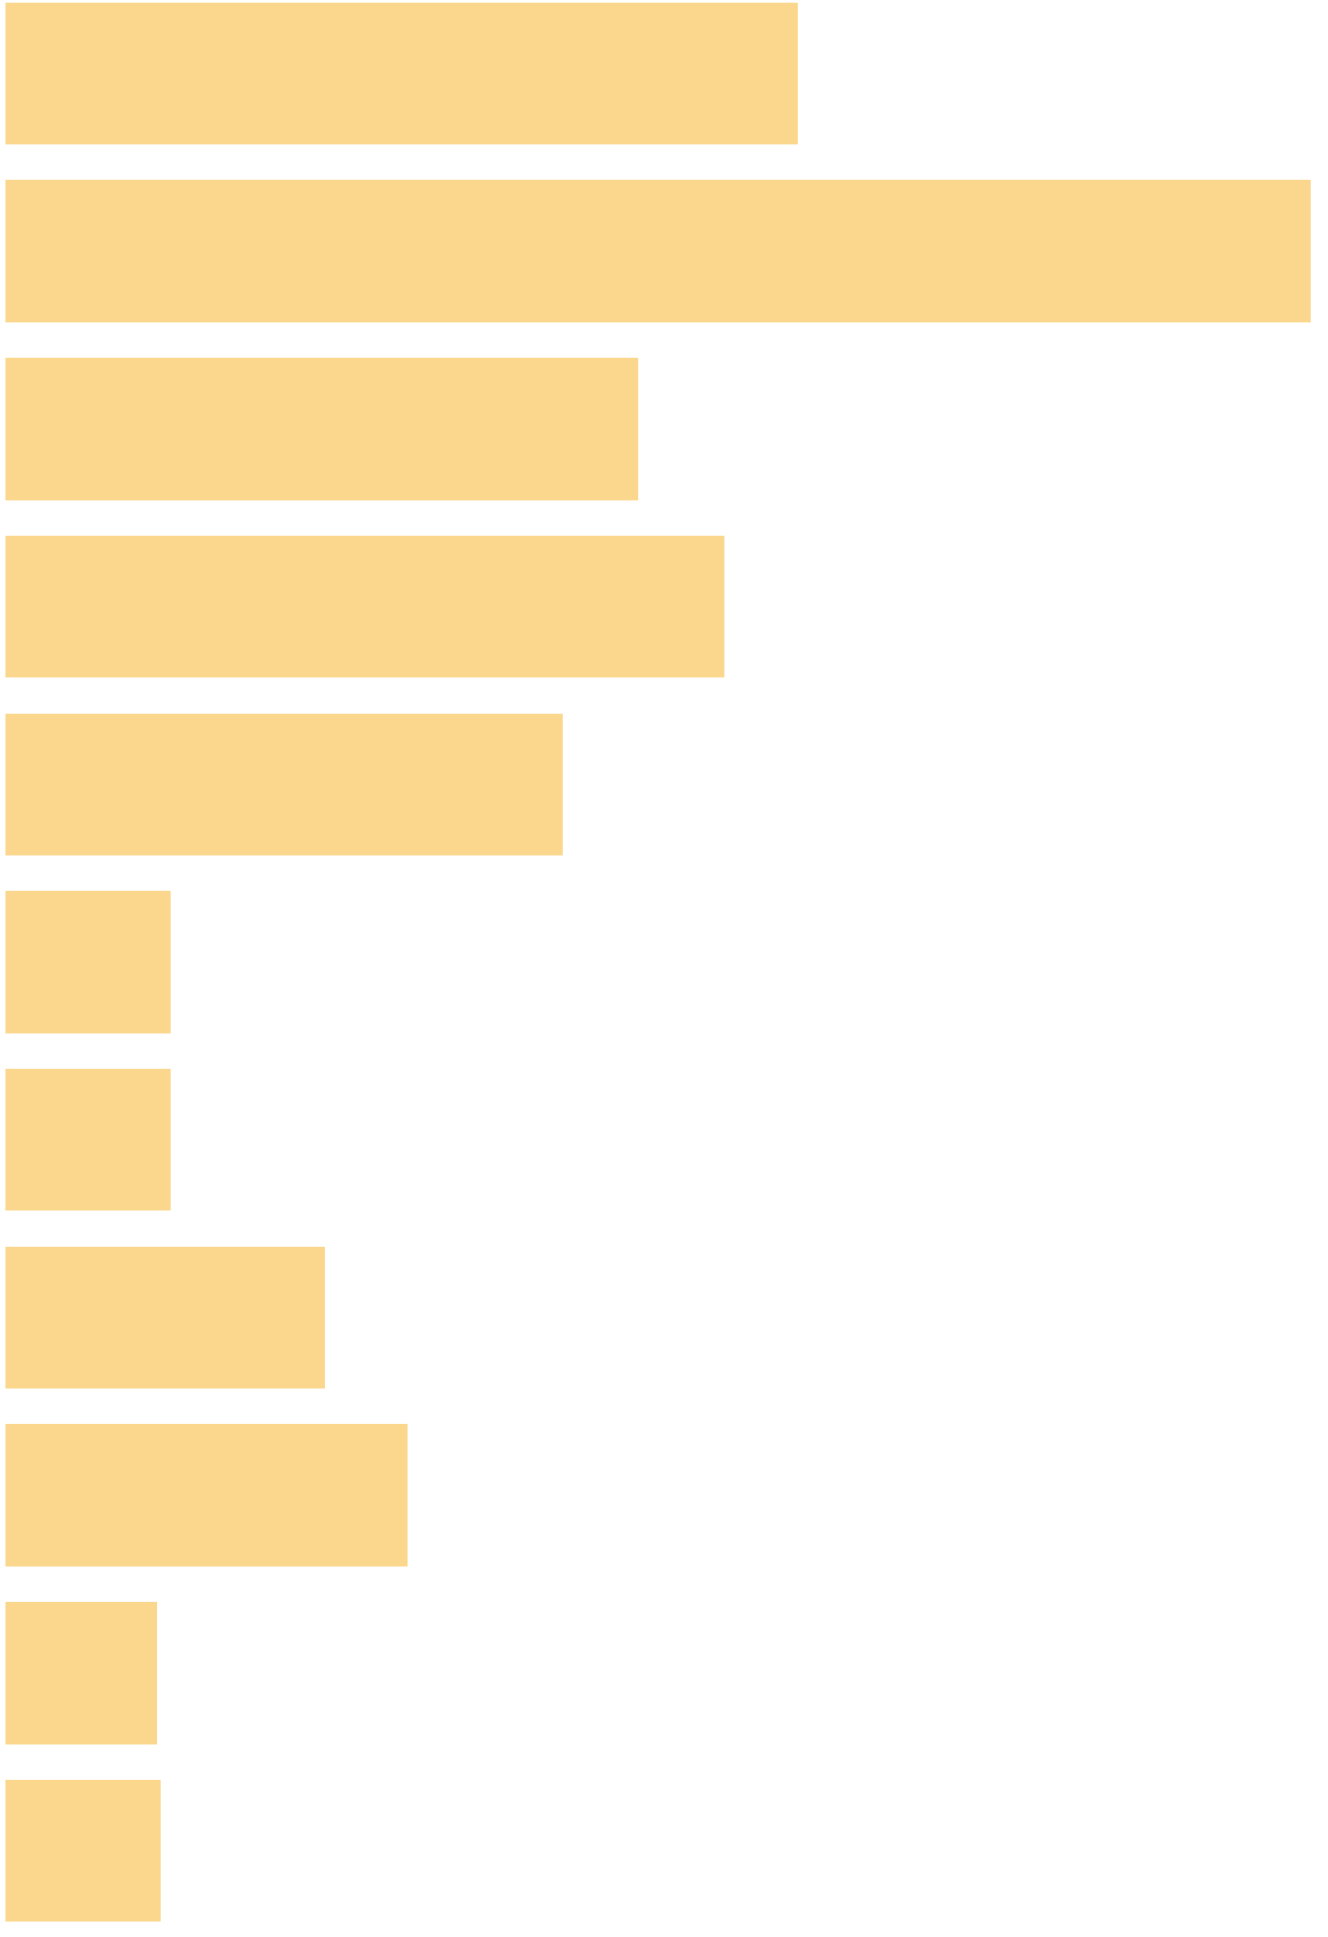
Yes, we can!
VERSE can learn similarity distributions
$$u$$
Self-supervised neural network^{[1]}
Node similarities
$$u$$
$$W$$
$$W^{T}$$
representation
Q1: Which similarities can we possibly represent?
Q2: What other methods have to do with similarities?
Notes:
Man shall not live by bread alone

Slide 9
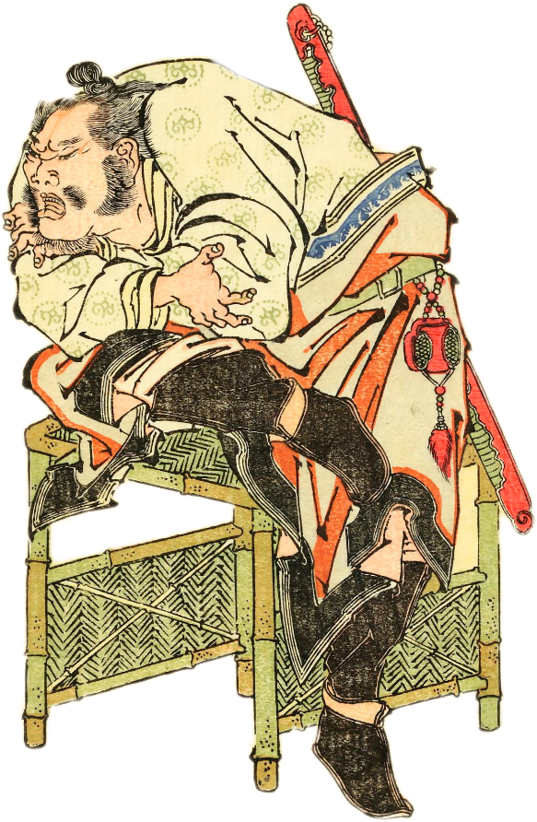
Why similarities?
We can measure quality explicitly
We can easily change the similarity
  We test VERSE with PPR, SimRank, and adjacency
Thinking about similarities provides insight
  We show DeepWalk & node2vec ≈ PPR
  VERSE uses 1 parameter instead of 5
Why should I bother about similarities?
Notes:
Man shall not live by bread alone

Slide 10

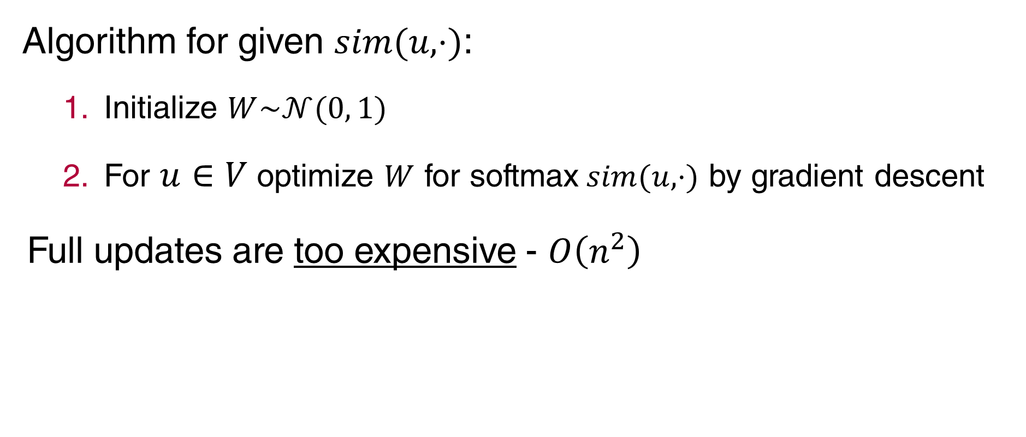



VERSE graph embedding
Algorithm for given $sim(u,⋅)$:
  Initialize $W\sim 𝒩(0, 1)$
  For $u∈V$ optimize $W$ for softmax$sim(u,⋅)$ by gradient descent
Full updates are too expensive - $O\left(n^{2}\right)$
$sim(u,⋅)$
$$u$$
$$W$$
$$W^{T}$$
We make it faster with sampling!
representation
Notes:
Man shall not live by bread alone

Slide 11
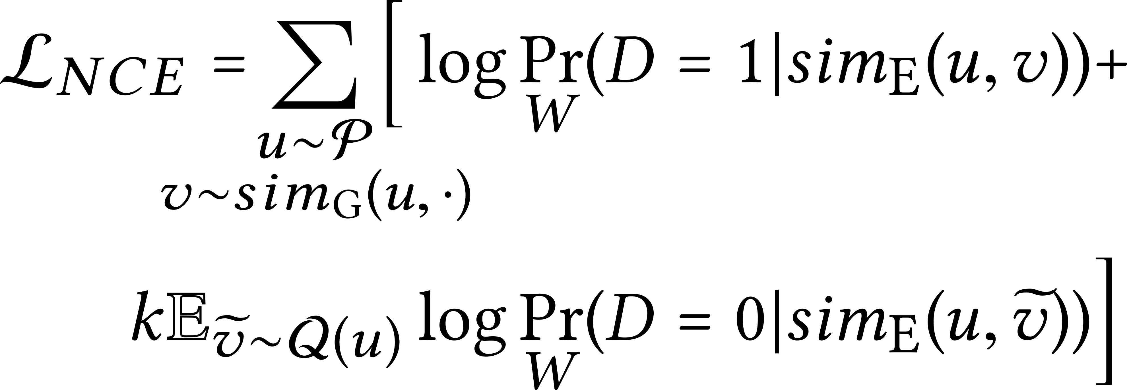
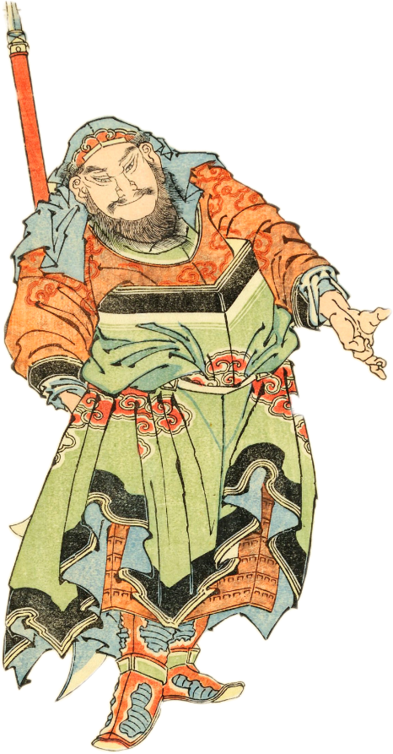
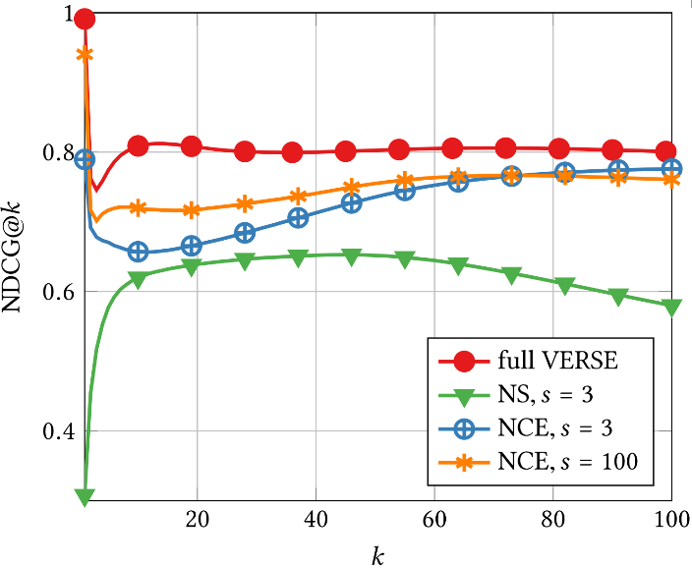
VERSE graph embedding: sampling
We use Noise Contrastive Estimation
Why not just using Negative Sampling?
Negative Sampling does not preserve similarities!
Notes:
Negative sampling does not normalize the log-prob in the second term
Actually, NS does not converge to whatever we want it to converge to!
Current state-of-the-art is running in the dark

Slide 12
Experimental setting
Graphs × tasks = problems
PPR as a default, HSVERSE with tuned similarity
Max one day on a 10-core server
  No GPU farms, everything fits in desktop RAM
Reimplement everything for performance
Code and data available (bit.ly/www-verse)
Notes:
New space and time analysis of node2vec: quadratic in the number of edges on average
C++ with Python wrapper for the lazy ones

Slide 13
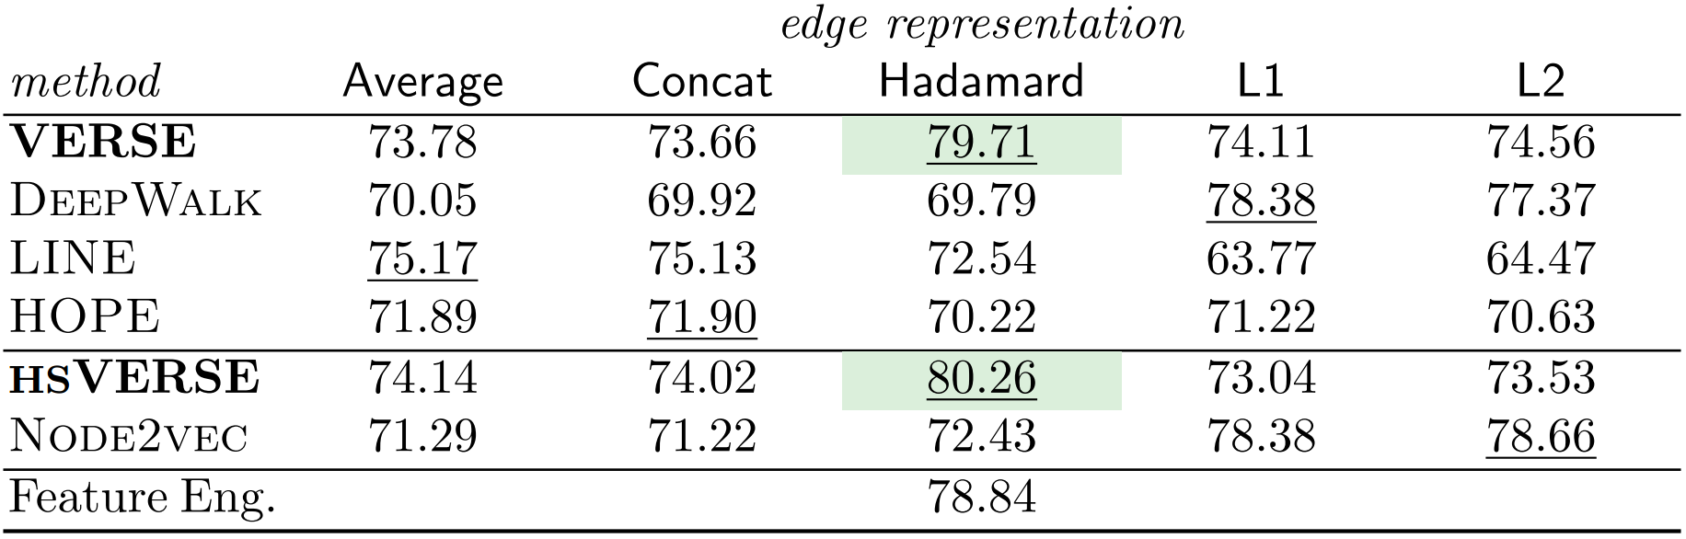
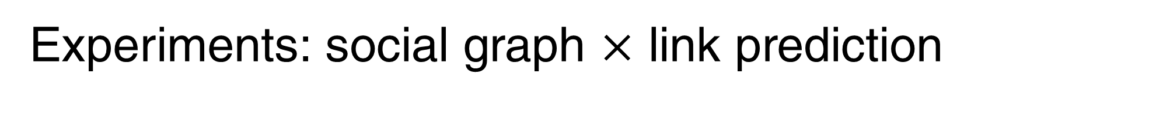
Experiments: social graph $×$ link prediction
Link prediction
(accuracy)
Notes:
Every other method worse than a simple baseline
Across graphs, need different edge representations, not for VERSE (NCE benefit)
Adamic-Adar, Preferential attachment, Katz, and Jaccard coefficient, degree of nodes

Slide 14
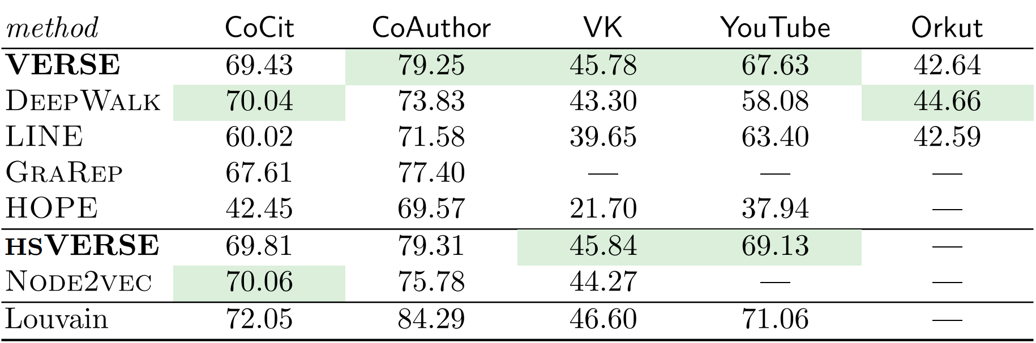
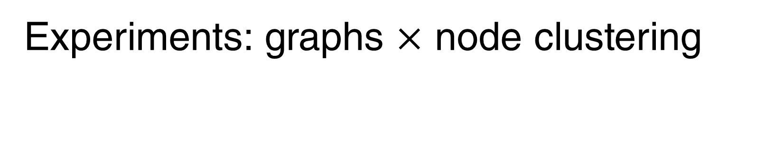
Experiments: graphs $×$ node clustering
Node clustering
(modularity)
Notes:
Man shall not live by bread alone

Slide 15
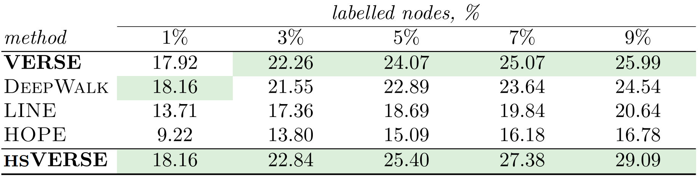
Experiments: web graph $×$ node classification
Classification
(accuracy)
Notes:
Man shall not live by bread alone

Slide 16
Conclusion
We provide new useful abstraction: node similarities
We create VERSE to explicitly work with similarities
We develop a scalable approximation via NCE
There is a room for improvement!
Notes:
Man shall not live by bread alone

Slide 17
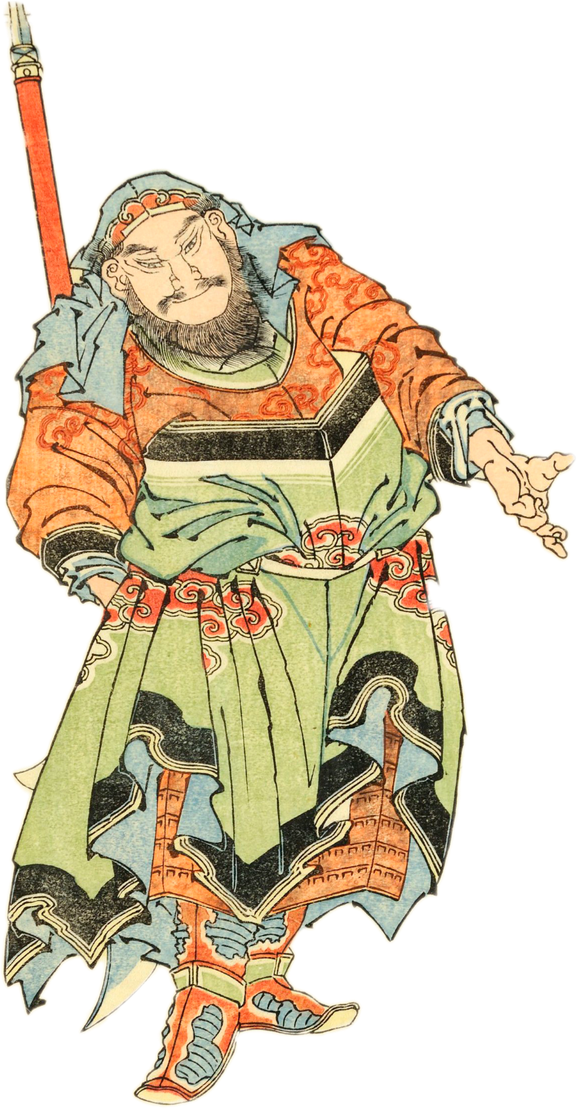
Thank you
for your attention!
bit.ly/www-verse
github.com/xgfs/verse
Thank you for attention!
Anton Tsitsulin
Knowledge Discovery and Data Mining
Hasso Plattner Institute

